Slide 1
Ab-initio MD Simulation of GeTe
Jason Larkin
CHE 24-623

Slide 2
Outline
What is GeTe
Ab-initio MD
Radial Distribution Function
Results from [3] Liquid
Results from [1] Amorphous
Results from [2] Amorphous and GST

Slide 3
Papers
[1] J. Akola, R.O. Jones Phys. Rev. Lett. 100, 205502 (2008). (Simulation)
[2] J. Akola, R.O. Jones Phys. Rev. B 76, 235201 (2007). (Simulation)
[3] J.Y. Raty, et al., Phys. Rev. B 65, 115205 (2002). (Experiment and Small Simulation)
[4] K. Hirota, et al., J. Appl. Phys. 82(1), 1997. (Experiment)
[5] D.B. Dove, et al., Appl. Phys. Lett. 16, 3 (1970). (Experiment)
All focus on the structural change from crystal->liquid->amorphous

Slide 4
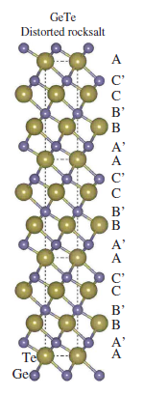
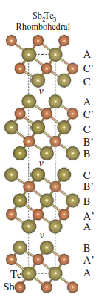
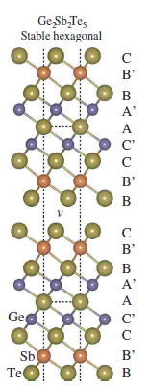
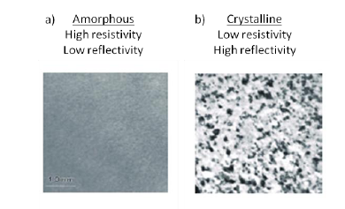
I. What is GeTe/PC Materials?
Phase Change Materials: Alloys of Ge, Sb, and Te.
Most Popular: Ge₂Sb₂Te₅
Composed of layers of GeTe and Sb2Te3 with vacancies
Contrast in Optical/Electrical properties between crystalline and amorphous phases.
Ex: difference in resistance 1K-1M Ohm.
+
=
Read/write: liquify, quench to amorphous, heat above re-crystallization T (~50 ns).

Slide 5

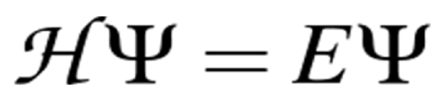
II. Ab-initio MD
Feynman-Hellman Theorem:
Assumption: electrons stay in their ground state as nuclei move.
Recipe
Given location of nuclei, species, calculate electronic structure.
Take the (analytic) derivative above.
Move nuclei (with say Verlet integration).
Repeat.
Most of time (again) in calculating forces, so solving better be fast!
CPMD code:
Flexible: if I want to go from GeTe->GST, simple!
http://www.cpmd.org/

Slide 6
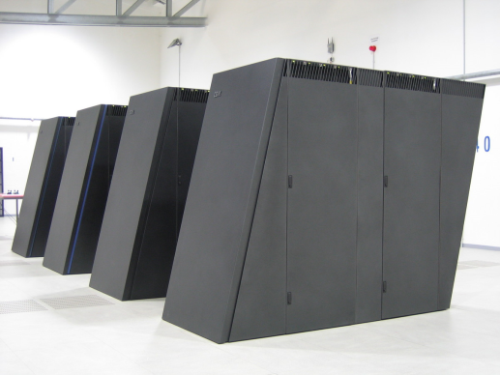
Computational Details
Calculation [1], [2] run on IBM Blue Gene/L, 512 CPUs for 1 month.
[1] includes 216 atoms in a 18.6 Ang. cube.
[2] includes same, 460 atoms GST.
[3] has only 64 atoms!
Melt T
[1],[2], NVT, dt=0.003 ps
5000K
1000K
300K
100K
50 ps
29 ps
115ps
26ps
96ps
219ps , expt.~(1000 ps)
[3], Langevin, dt=0.003 ps
-A similar melting cycle, but everything done in 11 ps!!!
Do results depend on this difference in quench times? NVE vs. NVT?
The entire read/write cycle takes ~50 ns, good luck…
No force-field potentials exists for these materials, so this is as good as it gets.

Slide 7
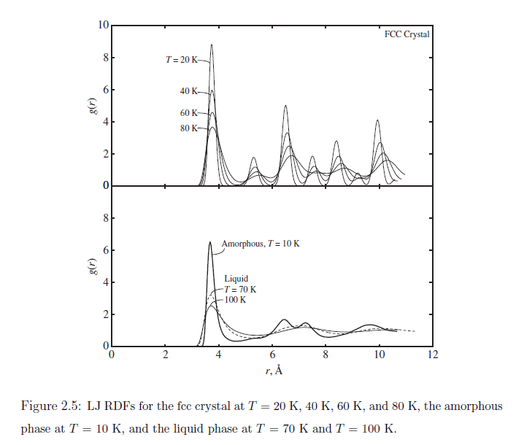
III. Radial Distribution Function
Radial Distribution Function (RDF) gives idea of short-range order for liquid/amorphous:
For LJ system, first peak in RDF very nearly same as FCC. True in general??
For multi-species systems, I can have multiple RDFs (looking at say Ge-Ge, Te-Te only).
-McGaughey PhD. Thesis

Slide 8
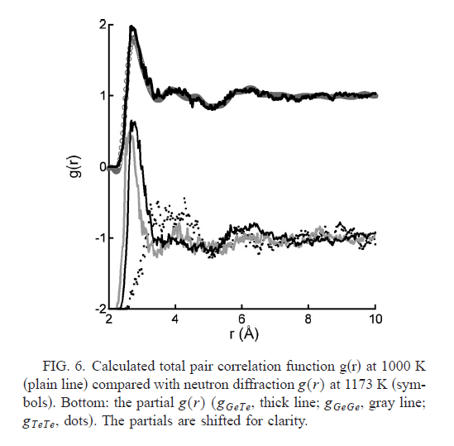
IV. Results from [3]
Peak at ~2.7 Ang.
Crystal bond
Ge-Ge and Te-Te
Liquid phase total RDF shows (much) shorter overall and Ge-Ge bonding than crystal.
Neutron diffraction (expt.) shows similar total RDF (short bonds).
With MD data, we can look at species-species RDFs.

Slide 9
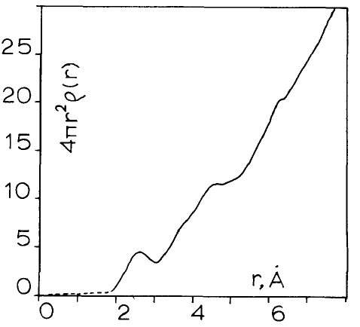
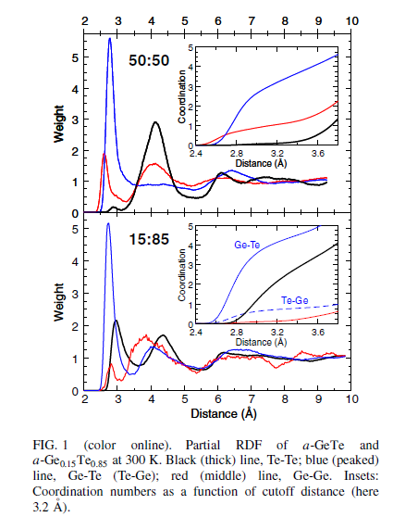
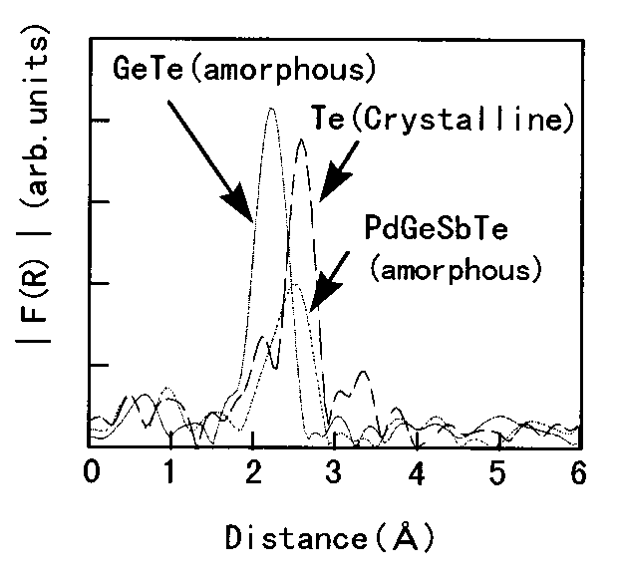
V. Results from [1]
With atom by atom data, we can decompose RDFs (structure factors) into individual components.
We see that overall and Ge-Ge bonds are much shorter in amorphous. Te-Te is close to crystal bond length.
Crystal bond Ge-Ge and Te-Te
[5]
Peak at ~2.6 Ang.
[4]
Peak at ~2.6 Ang.
(small diff. between graph and actual).

Slide 10
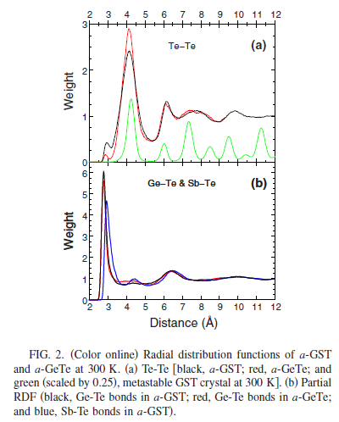
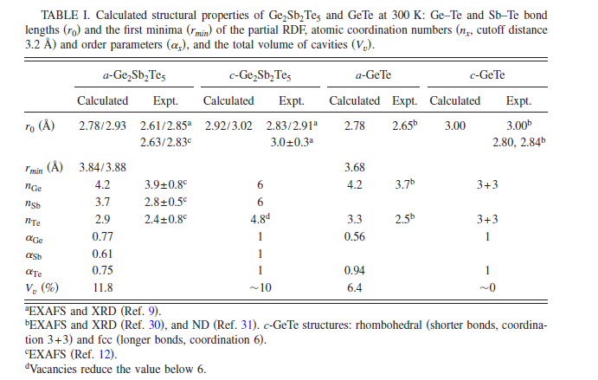
VI. Results from [2]
Again, shortened Ge-Ge and overall bonds, Te-Te nearly same as crystal.
Results for GST materials show similar trends, shortened overall bonds except Te-Te.
Crystal bond Ge-Ge and Te-Te

Slide 11
Summary
Ab-initio MD flexible, can simulate many systems accurately.
Very expensive, can (mostly) study bulk-like properties.
GeTe Amorphous/Liquid phase total RDF shows (much) shorter overall bonding than crystal.
This is due (primarily) to Ge-x bonding which prefers tetrahedral. Very difficult to capture this with force-field potential!

